Slide 1
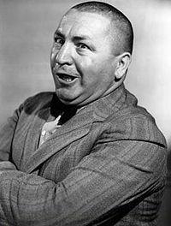

Modern Services Demand A DevOps Culture Beyond Apps
Glenn O’Donnell Vice President and Research Director
October 22, 2014
Happy 111th Birthday, Curly!
@GlennODonnell

Slide 2


It’s NOT about technology It’s about SERVICES!
$
€
¥
£

Slide 3

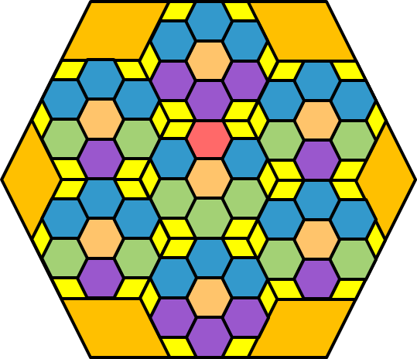
Service design is modular
Drill Down
Drill Down
Business Service
Assembly of Sub-Services
Infrastructure & Applications
Practice systems engineering

Slide 4
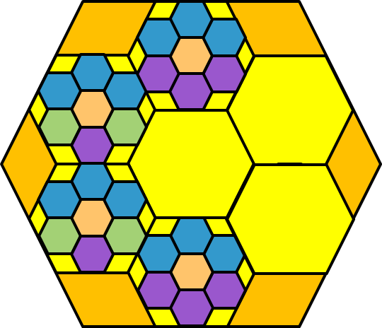
Components form a rich ecosystem
Application
Database
Private IaaS Cloud
Virtual Infrastructure
Physical Infrastructure
Mainframe
SaaS Application
Business Partner Service
Directory Service
Public Cloud IaaS
Hosted Private Cloud
Traditional Hosting Service
Internal Components
External Components

Slide 5
Everything is now software (even hardware)
Application
Application
Database
Private IaaS Cloud
Virtual Infrastructure
Physical Infrastructure
Mainframe
SaaS Application
Business Partner Service
Directory Service
Public Cloud IaaS
Hosted Private Cloud
Traditional Hosting Service
Application
Infrastructure
SaaS Application
Database
Business Partner Service
Private IaaS Cloud
Directory Service
Virtual Infrastructure
Public Cloud IaaS
Physical Infrastructure
Hosted Private Cloud
Mainframe
Abstraction
Traditional Hosting Service
Abstraction
Internal Components
External Components

Slide 6
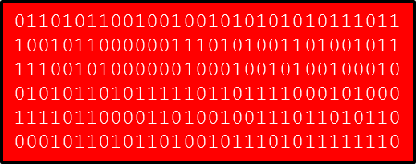
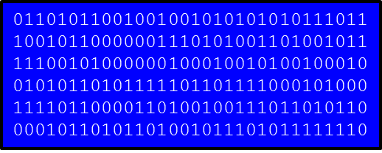
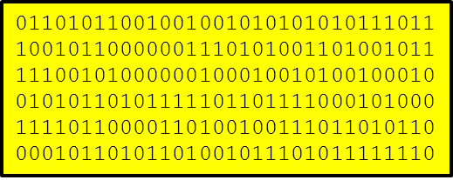
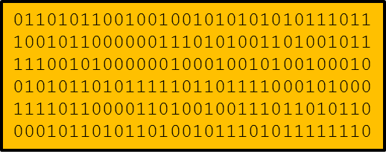
Software = Models

Slide 7
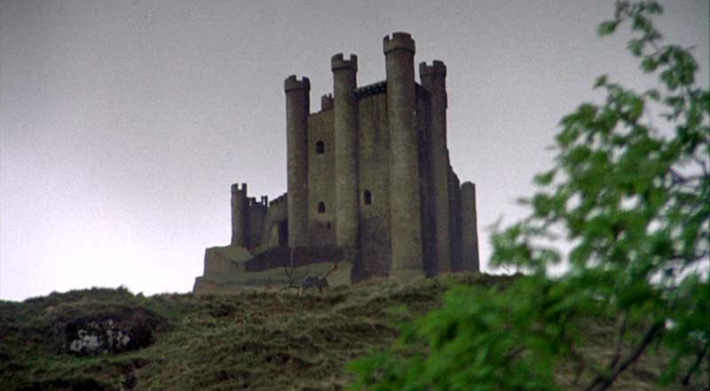
It’s only a model!

Slide 8
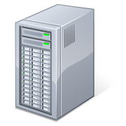

You can automate if you have a model
All of this is System Software
01101011001001001010101010111011 10010110000001110101001101001011 11100101000000100010010100100010 01010110101111101101111000101000 11110110000110100100111011010110 00010110101101001011101011111110
Drives
Produces
Software Model
Automation Tool
Service
Treated The Same as Application Software
Automation is central to DevOps

Slide 9
It’s only a model? It’s the secret code!
"created": "2014-10-22T21:11:09Z",
"flavor": {
"id": "1",
"links": [
{
"href": "http://openstack.example.com/openstack/flavors/1",
"rel": "bookmark"
}
]
},
"hostId": "65201c14a29663e06d0748e561207d998b343e1d164bfa0aafa9c45d",
"id": "893c7791-f1df-4c3d-8383-3caae9656c62",
"image": {
"id": "70a599e0-31e7-49b7-b260-868f441e862b",
"links": [
{
"href": "http://openstack.example.com/openstack/images/70a599e0-31e7-49b7-b260-868f441e862b",
"rel": "bookmark"
}
]
},

Slide 10
Be the automator – not the automated
Dying Jobs
Growing Jobs
Systems administrator
Network administrator
Storage administrator
Database administrator
ITIL & tech zealots
Focus on silo technologies
Automation architect
Business relationship mgr
Service engineer
Workflow/process experts
Customer advocates
Focus on services
Sustainers
Innovators

Slide 11
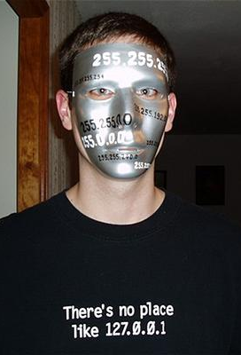

What happens to the Geeks?
Geek
Performs geek work
Loves change
Innovator
Wonderful
Future!
Geek Imposter
Performs geek work
Dislikes change
Sustainer
Doomed!
Photo Credit:

Slide 12
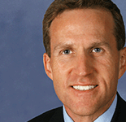
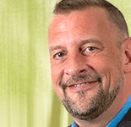


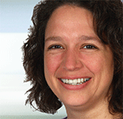
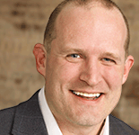
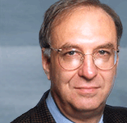
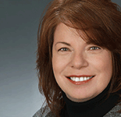
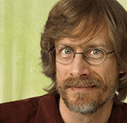
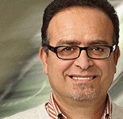
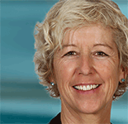
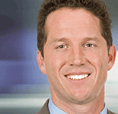
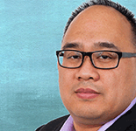
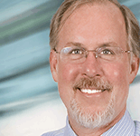
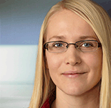
How can you help me?
We want to hear your stories!
We are changing the world together!
Dev
Ops

Slide 13

Join The
v
o
l
u
t
o
e
i
n
R
Revolution
Glenn O’Donnell
+1 617.613.8826
godonnell@forrester.com
@GlennODonnell

